Slide 1
Cluster analysis 2017 nevada state home loans
DANA-4840-001 Classification II

Slide 2
Team members
Name id
Leo Liang
Qirui Cao
Young Lee
Latesh Subramanyam
100244775
100290055
100366055
100365556

Slide 3
TABLE OF CONTENTS
01
Problem and objective
02
Pre-processing
03
Clustering analysis
04
conclusion
K Means K Medoids Hierarchical Clustering
Conclusion
Improvement

Slide 4

Problem define and objective
According to the research conducted by U.S. Department of Housing and Urban Development in 2016, Nevada state was the worst state for affordable housing in the United States.
For each record in the original data, there is information related to loan, the property characteristics, the applicant and lender demographics.
Some of the information (variables) are removed and modified to reduce irrelevant information for the classification analysis.
Our team implemented the classification analysis, including k-means, k-medoid, hierarchical and density-based clustering method, to find the characteristics of the consumers who applied for the mortgage in Nevada state.
Target Audience: Anyone interested in how various customer information affects mortgage applications
Our recommended audience for this cluster analysis may specifically help lawmakers who need to identify patterns and bias or prejudice in mortgage approvals for .

Slide 5
Pre-processing
original data
The original data contains 178,587 rows and 79 columns (variables)
5,201,754 Nulls and 796 Duplicates
Outlier detection is only conducted on the cleaned data set
Cleaned data
The cleaned data contains 2,000 rows (Sampled) and 16 columns (variables)
0 Nulls and 0 Duplicates (Completed cases)
85 Outliers detected by Mahalanobis Distance
75 Outliers detected by Density-Based Spatial Clustering of Applications with Noise

Slide 6
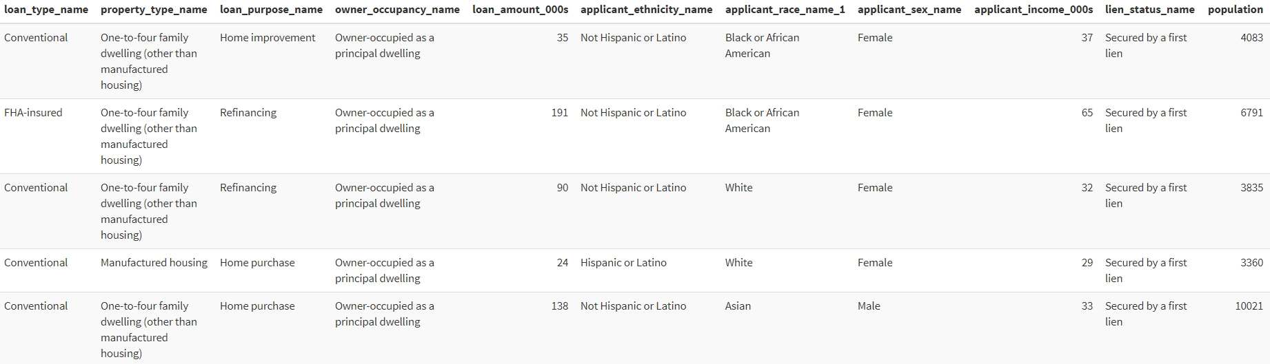
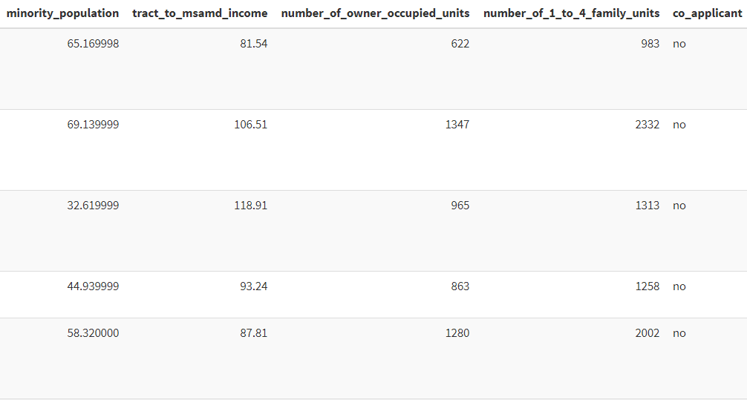
Data overview

Slide 7
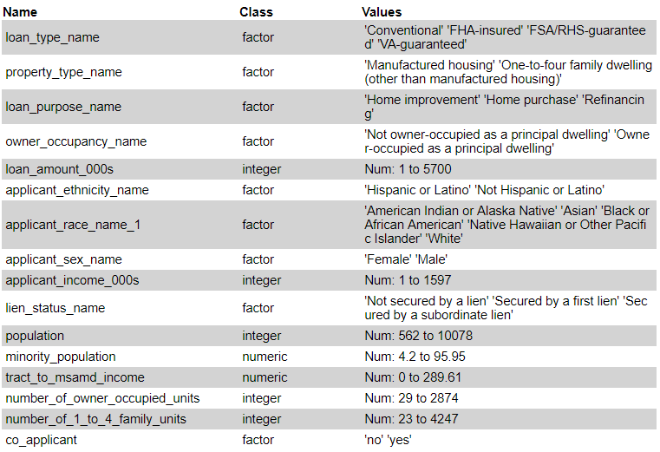
Variable table

Slide 8
Clustering analysis – how many clusters?
K means
K medoids
1. Gower
1. Gower
SW Score: 2
CH Score: 2
SW Score: 5
2. Euclidean
2. Euclidean
SW Score: 2
CH Score: 2
SW Score: 2

Slide 9
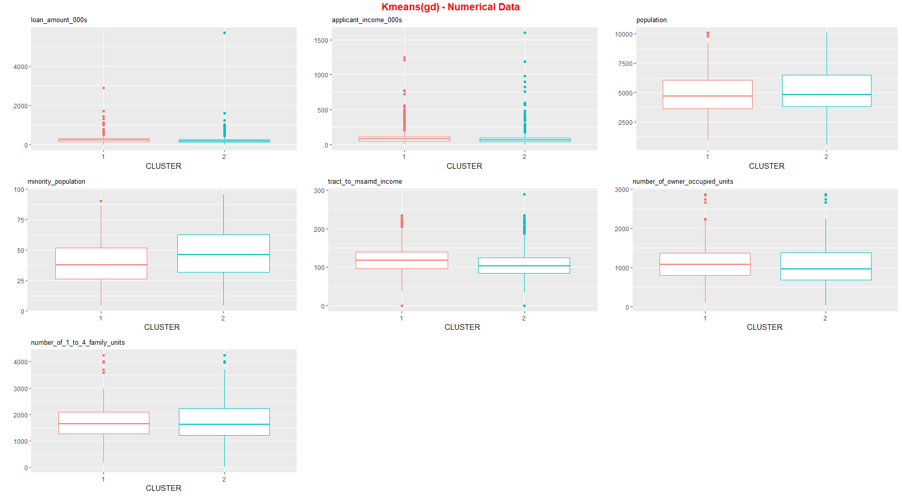
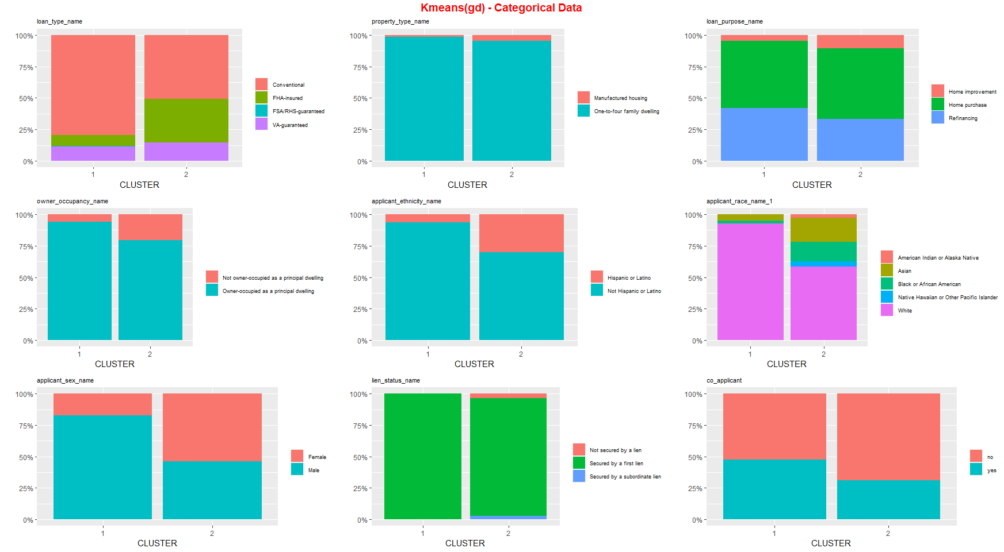
Clustering analysis – k means (gd)
No significant difference can be seen from the gower distance model

Slide 10
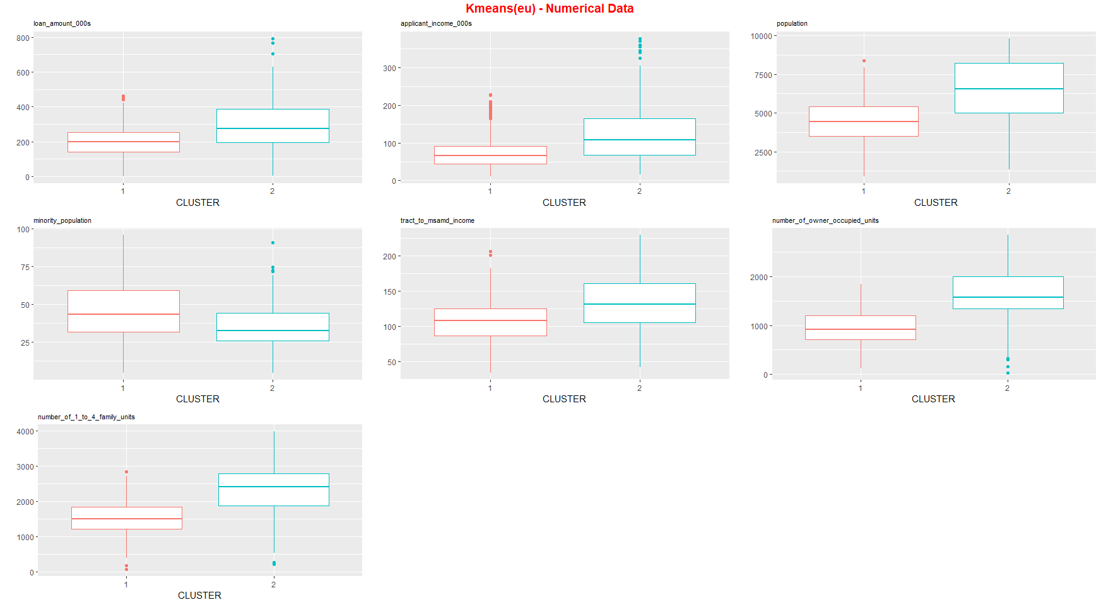
Clustering analysis – k means (eu)

Slide 11
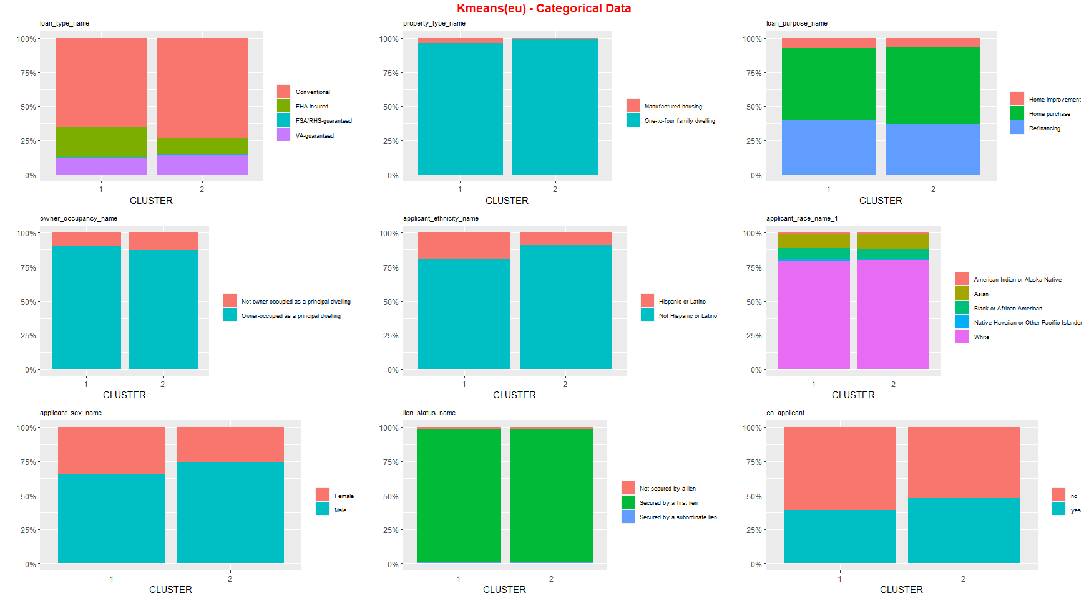
Clustering analysis – k means (eu)
No significant difference can be seen from the categorical variables

Slide 12
Cluster interpretation – k means (eu)
cluster 1 - Small town, more minority, less nuclear family
Less loan amount
Less applicant income
Less population of city/town/area
More minority population
Less Metropolitan Statistical Area/Metropolitan Division income
Less number of owner occupied units in the area
Less number of family of 1 to 4 units in the area
cluster 2 - larger town, more majority, more nuclear family
More loan amount
More applicant income
More population of city/town/area
Less minority population
More Metropolitan Statistical Area/Metropolitan Division income
More number of owner occupied units in the area
More number of family of 1 to 4 units in the area
No significant difference can be seen from the categorical variables

Slide 13
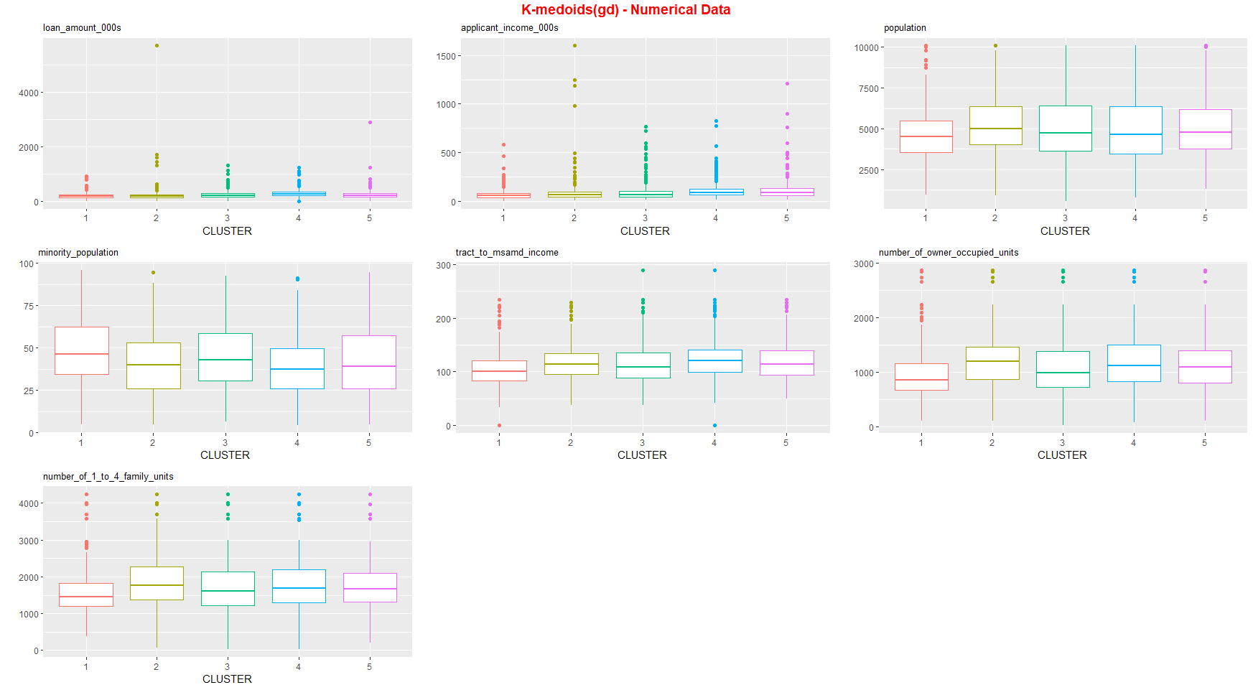
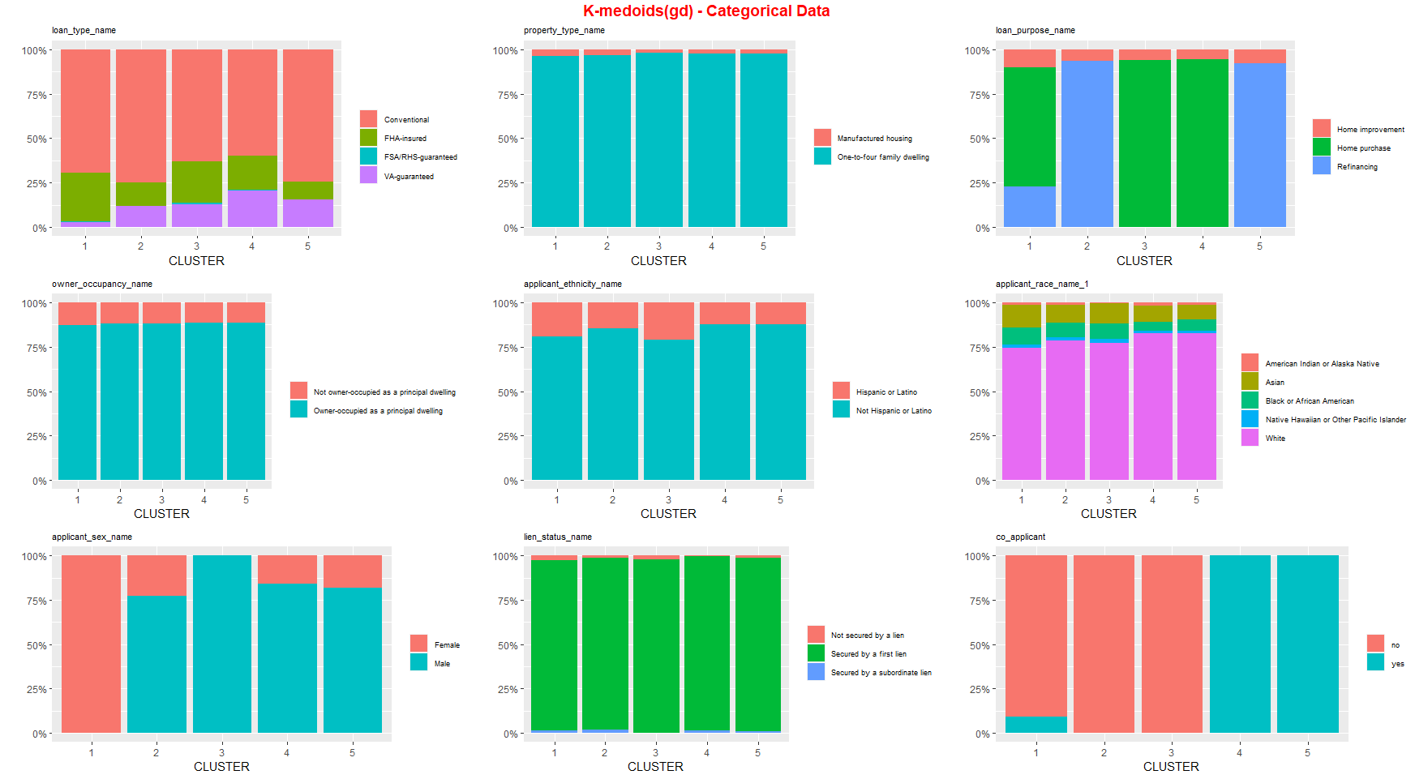
Clustering analysis – k medoids (gd)
No significant difference can be seen from the gower distance model

Slide 14
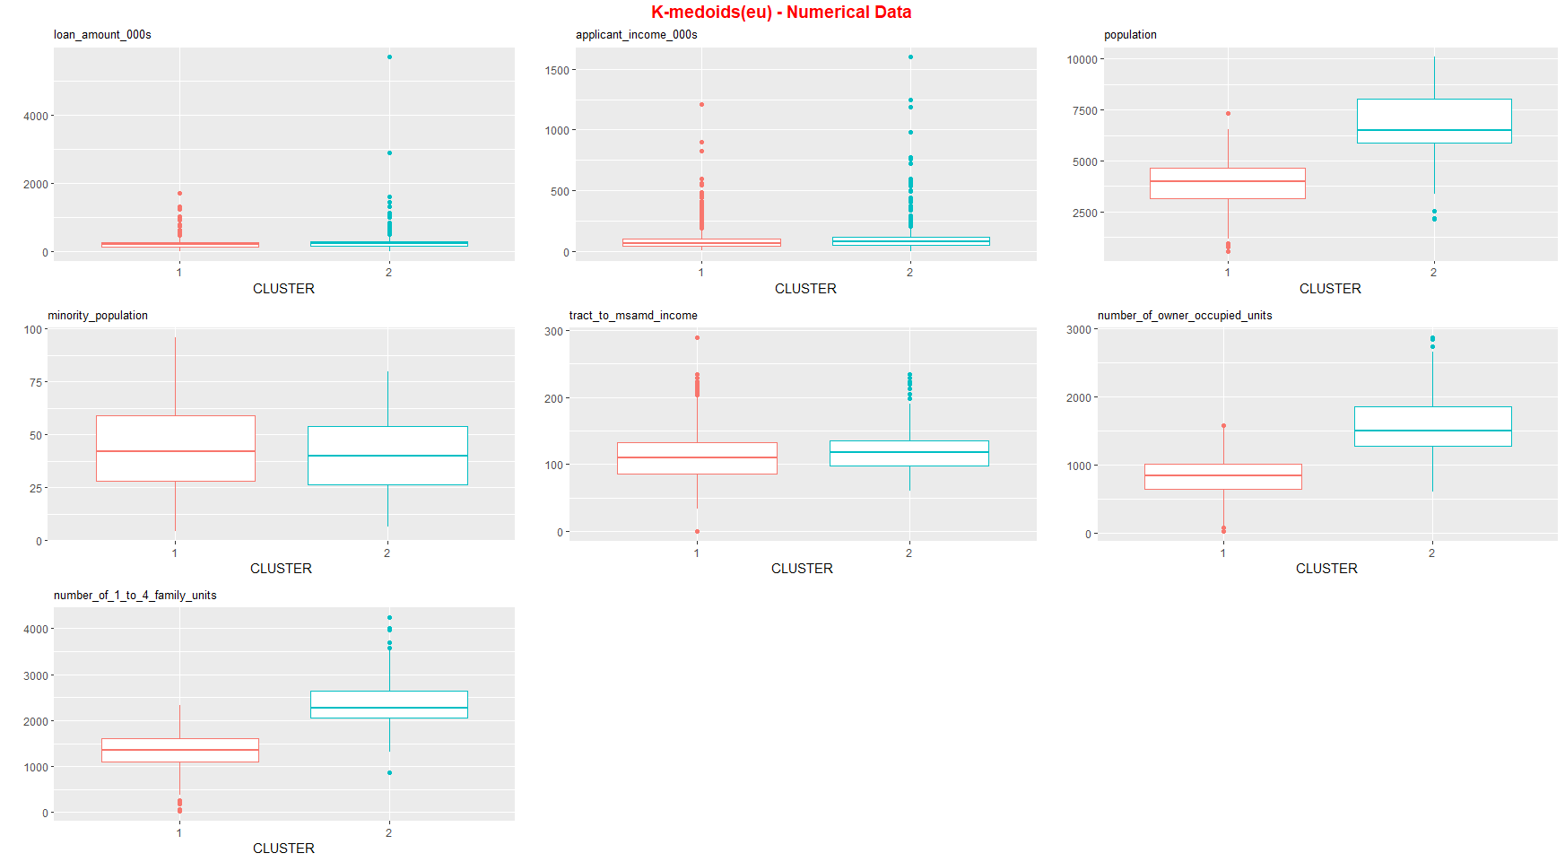
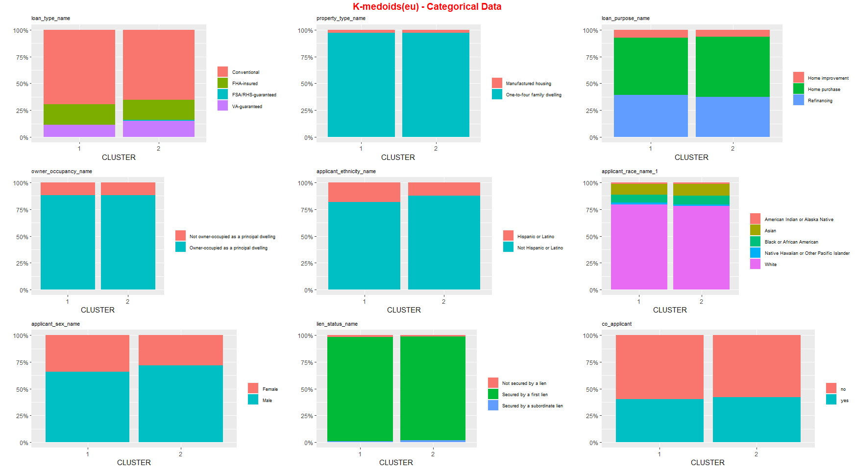
Clustering analysis – k medoids (eu)
No significant difference can be seen from the categorical variables

Slide 15
Cluster interpretation – k medoids (eu)
cluster 1 - Small town, less nuclear family
Less population of city/town/area
Less number of owner occupied units
Less number of family of 1 to 4 units
cluster 2 - larger town, more nuclear family
More population of city/town/area
More number of owner occupied units
More number of family of 1 to 4 units
No significant difference can be seen from the categorical variables

Slide 16
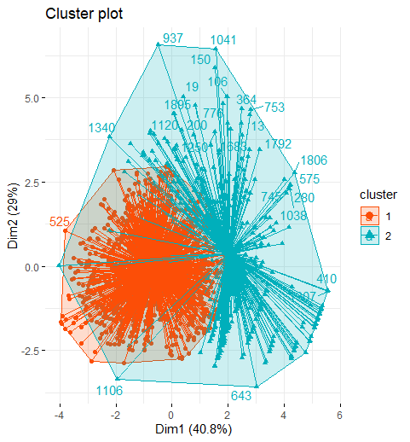
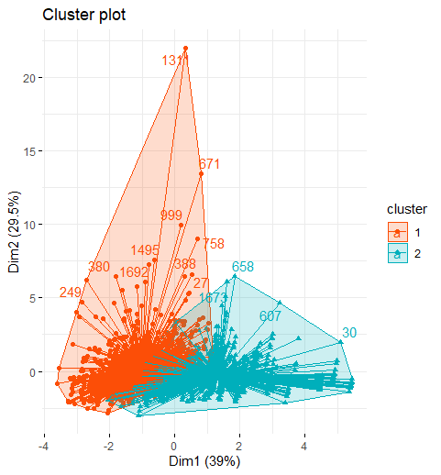
Clustering analysis – quality of clusters
Cluster plots - numerical variables only
K medoids have better performance but not the best clustering because of the overlap
k means
k medoids

Slide 17
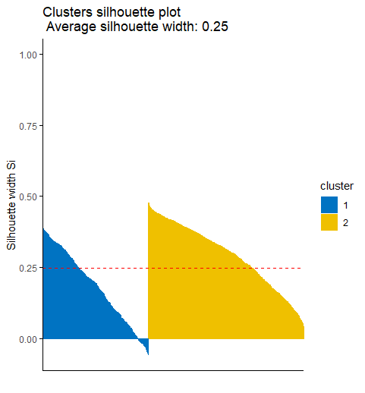
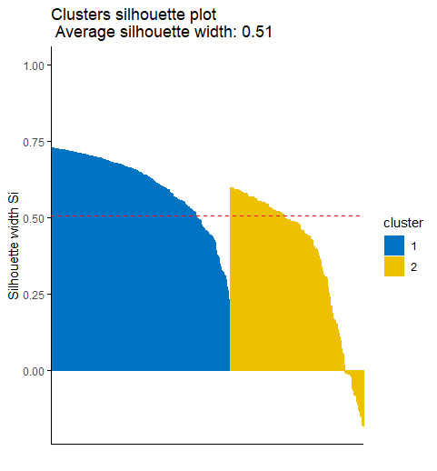


Clustering analysis – quality of clusters
The average of silhouette width also suggests that K medoids performs better than k means because it measures how similar a data point is to its own cluster compared to the other clusters.
(This is also known as cohesion and separation)
Next, hierarchical clustering with density-based clustering are implemented for comparison because numerical variables dominated in k means and k medoids clustering.
k means
k medoids

Slide 18
density-based clustering - Outlier Detection
K-Means and K-Medoids methods are sensitive towards noise and outliers
To address this concern we can apply DBSCAN algorithm to separate noise and outliers.
We use KNN displot to identify the elbow and select appropriate epsilon and we opted for minpts to be 50
We use the Gower Distance Dissimilarity matrix as the input for the algorithm and table the classification against (of numerical only) mahalanobis outliers.

Slide 19
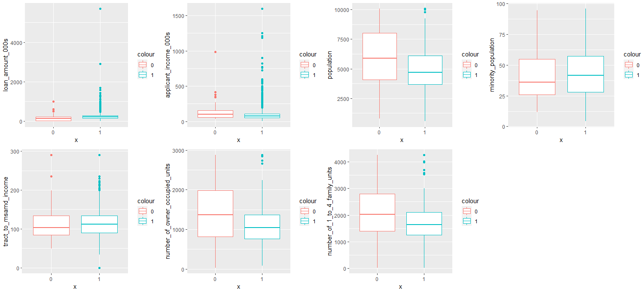
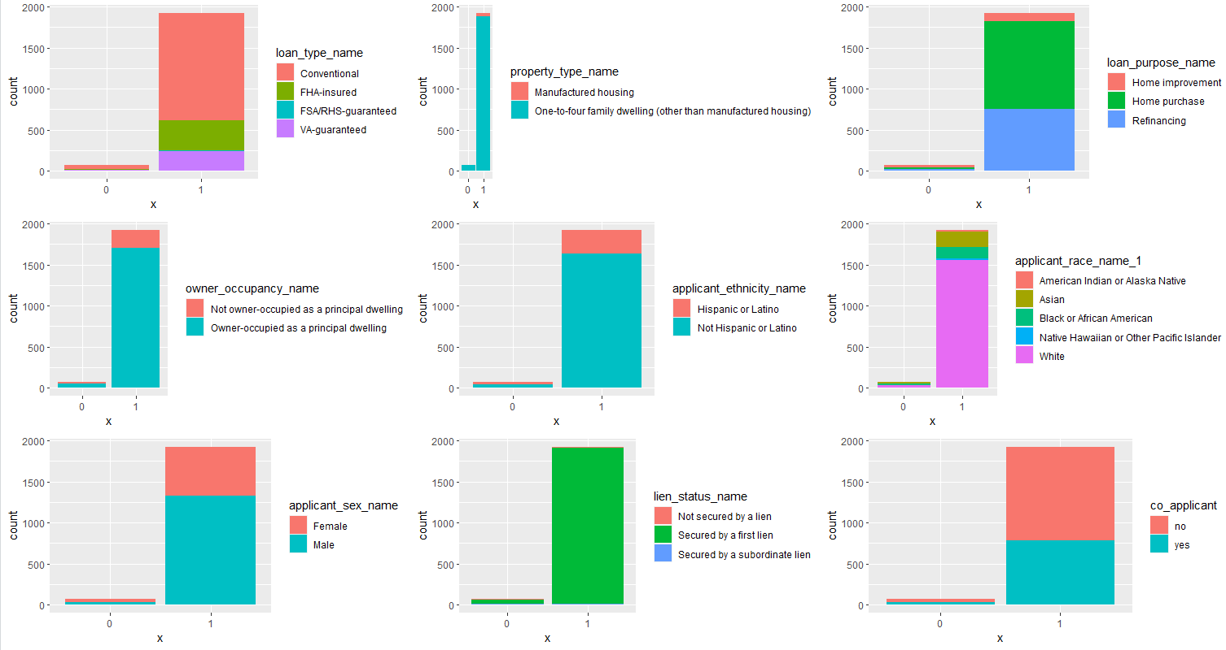
density-based clustering - Outlier Detection

Slide 20

density-based clustering - Outlier Detection
As we can observe from the boxplots above, outliers (DB=0) have relatively lower loan amount and higher income.
Meanwhile the frequency table suggests that outliers are more likely to be rejected
applications (42/75) rather than (636/1925), which contradicts to the common sense
that higher income and lower loan, more likely the application is approved. But this maybe due to other factors such as lower return on investment or credit issues .
Thus, removing the DBSCAN outliers can reduce the impact of the corner cases.
This will also help better clustering output reducing the effect of outliers.

Slide 21
Clustering analysis – hierarchical clustering
Linkage (sw score) | k = 2 | k = 3 | k = 4 | k = 5 | k = 6 | k = 7 | k = 8
single | 0.1793 | 0.1078 | 0.0382 | -0.0616 | -0.0837 | -0.1122 | -0.1396
complete | 0.1883 | 0.1593 | 0.1349 | 0.1413 | 0.1162 | 0.1266 | 0.1269
average | 0.1793 | 0.0748 | 0.1067 | 0.0808 | 0.0817 | 0.1360 | 0.1477
ward.d2 | 0.1396 | 0.1613 | 0.1832 | 0.1783 | 0.1643 | 0.1503 | 0.1547
Complete outperforms single and average for each k, while k = 2 gives complete linkages the maximized silhouette width.

Slide 22

Clustering analysis – hierarchical clustering
Let’s start with k = 2, complete linkages. Cluster 2 has a higher chance to get an approval .
From the boxplots and frequency plots in the next two slides, we can tell that cluster 2 has a lower loan amount (in terms of average and extreme values) and a lower level of variety in terms of loan amount and income.
Also, cluster 2 is more likely to be caucasian, or mortgage for primary residence, or the mortgage is secured.

Slide 23
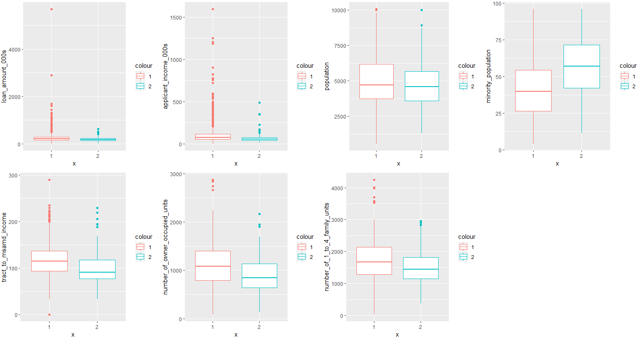
Clustering analysis – hierarchical clustering (k=2)

Slide 24
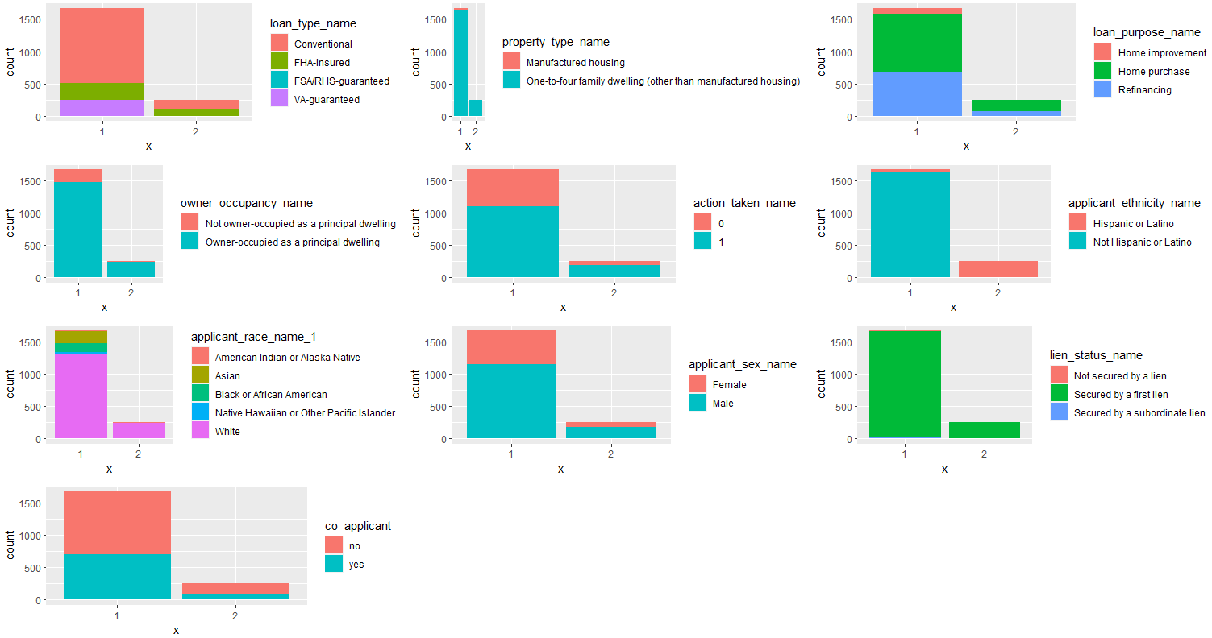
Clustering analysis – hierarchical clustering (k=2)
Categorical variables matter more

Slide 25
Clustering analysis – hierarchical clustering (k=2)
cluster 1 - Diversified race, more investment mortgage
More racial diversity
More likely to be an investment loan
More cases not secured by a lien
More income/loan amount variation
cluster 2 - mono-race, more principal residence mortgage
Less racial diversity, mostly white and hispanic
More likely to be a principal residence
More cases secured by a first lien or a second lien
Less income/loan amount variation

Slide 26


Clustering analysis – hierarchical clustering
Expand K from 2 to 3
Expand k to 3, and the extra clustering spilt cluster 1 into two clusters. Cluster 3 is more likely to get an approval.

Slide 27
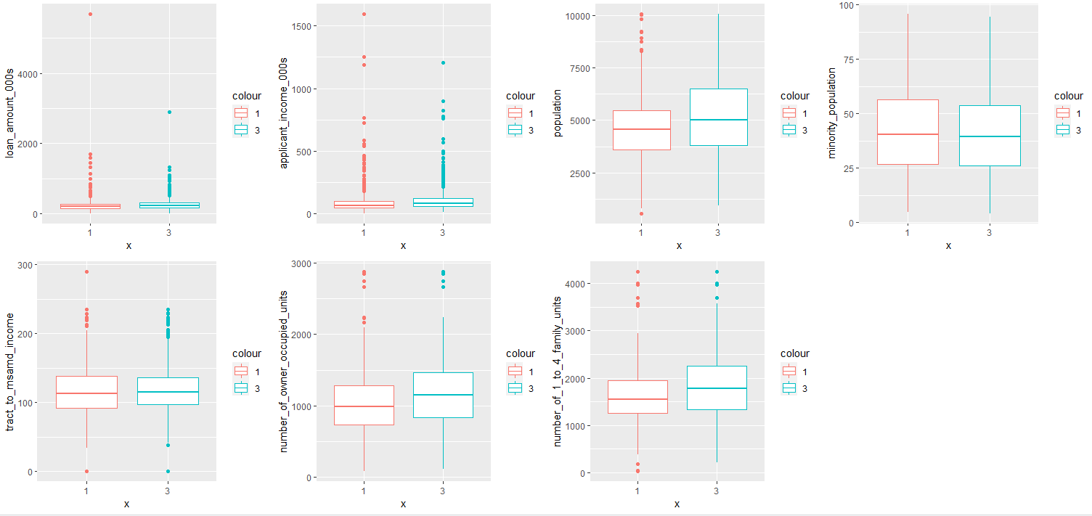
Clustering analysis – hierarchical clustering
Expand K from 2 to 3

Slide 28
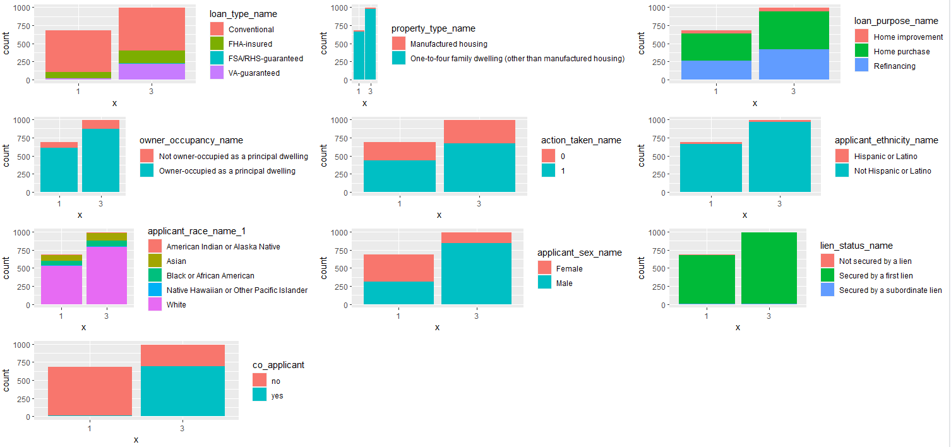
Clustering analysis – hierarchical clustering
Expand K from 2 to 3

Slide 29
Clustering analysis – density-based clustering EXPAND K FROM 2 TO 3
cluster 1 - more conventional mortgage, no co-applicant, less male
More Conventional mortgage
Less likely to have a co-applicant
Less likely to be a man
cluster 3 - MORE incentive program involved, co-applicant, more male
More VA-Guaranteed cases (veteran related )
More likely to have a co-applicant
More likely to be a man

Slide 30
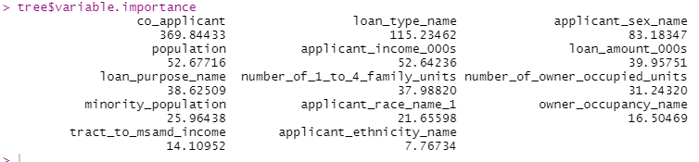
Clustering analysis – hierarchical clustering
Expand K from 2 to 3 and more
co_applicant and loan type plays the most important role in hierarchical clustering when k expands from 2 to 3, which coincides with our observations.
Sequentially, loan type helps the most splitting the cluster when k expands from 3 to 4, co_applicant again splits the cluster when k expands from 4 to 5, and applicant’s gender and race helps splitting the cluster when k expands from 5 to 6.

Slide 31
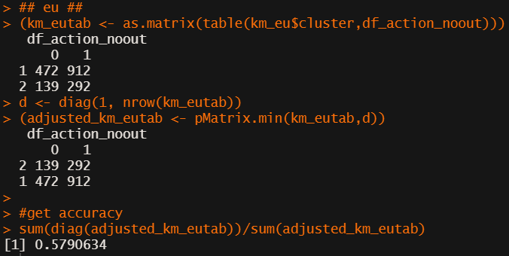
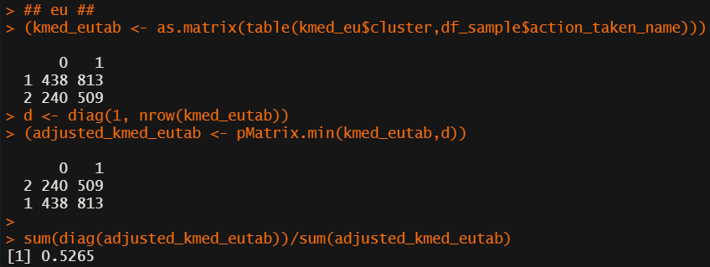
Prediction of mortgage application
Can we predict the outcome of mortgage application by the characteristics of the applicant?
K means
Accuracy: 58%
K medoids
Hierarchical Clustering
Accuracy: 53%
Accuracy: 59%

Slide 32
conclusion - summary
partitioning methods - k means and k medoids
More significant differences in the numeric variables between the clusters
Both K means and K medoids methods shows less population of city/town/area, less number of owner occupied units, L=less number of family of 1 to 4 units for cluster 1 and more population of city/town/area, more number of owner occupied units, more number of family of 1 to 4 units for cluster 2.
hierarchical clustering
More significant differences in the categorical variables between the clusters
Hierarchical clustering shows more racial diversity, more likely to be an investment loan, more cases not secured by a lien, more income/loan amount variation for cluster 1 and less racial diversity, mostly white and hispanic, more likely to be a principal residence, more cases secured by a first lien or a second lien, less income/loan amount variation for cluster 2.
co_applicant and loan type plays the most important role in hierarchical clustering
Hierarchical clustering shows

Slide 33
Further research and improvement
How to improve your clustering analysis in future?
For the mortgage specialists, they probably look into qualitative criteria before evaluating the applicant’s ability to repay, such as loan type, principal residence, and other criteria such as gender, race.
We could apply the hierarchical clustering until all qualitative variables are well-split, then apply partition clustering within each cluster. In this way, we might see different selection criteria for repayment ability for different types of mortgage.
The clustering classification was implemented with 2,000 sampled data because of resource issue. The randomness and small volume of data might have some impact on the quality of clusters.
Some variables, such as lien security, property type, are not balanced?. We can remove those variables for better clustering results.

Slide 34
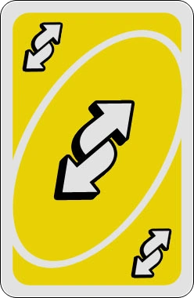
Qna

